Slide 1
Foreigner's '중고나라'

Slide 2
Plan
Provide a market place for foreigners in Korea to buy and sell secondhand goods.
Multi-platform support (web/iOS/Android).
Simple UI
Needs to be easy to sort by region

Slide 3
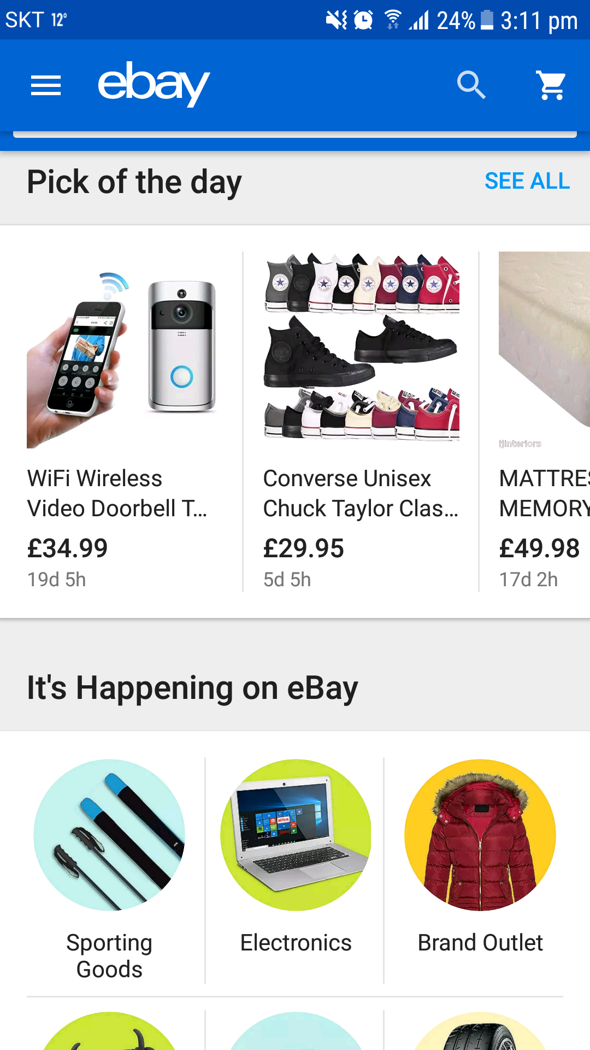
Case Studies: Ebay
Welcome page
Search always available
Sponserd posts

Slide 4
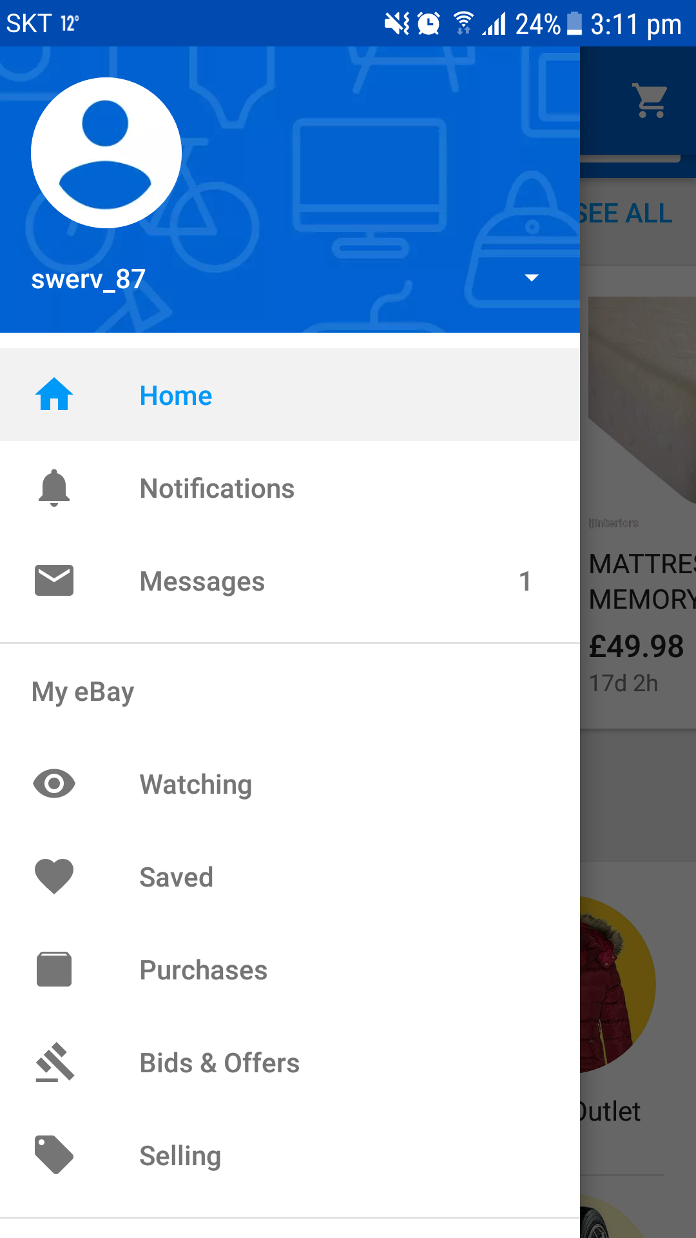
Case Studies: Ebay
Navigation Tray

Slide 5
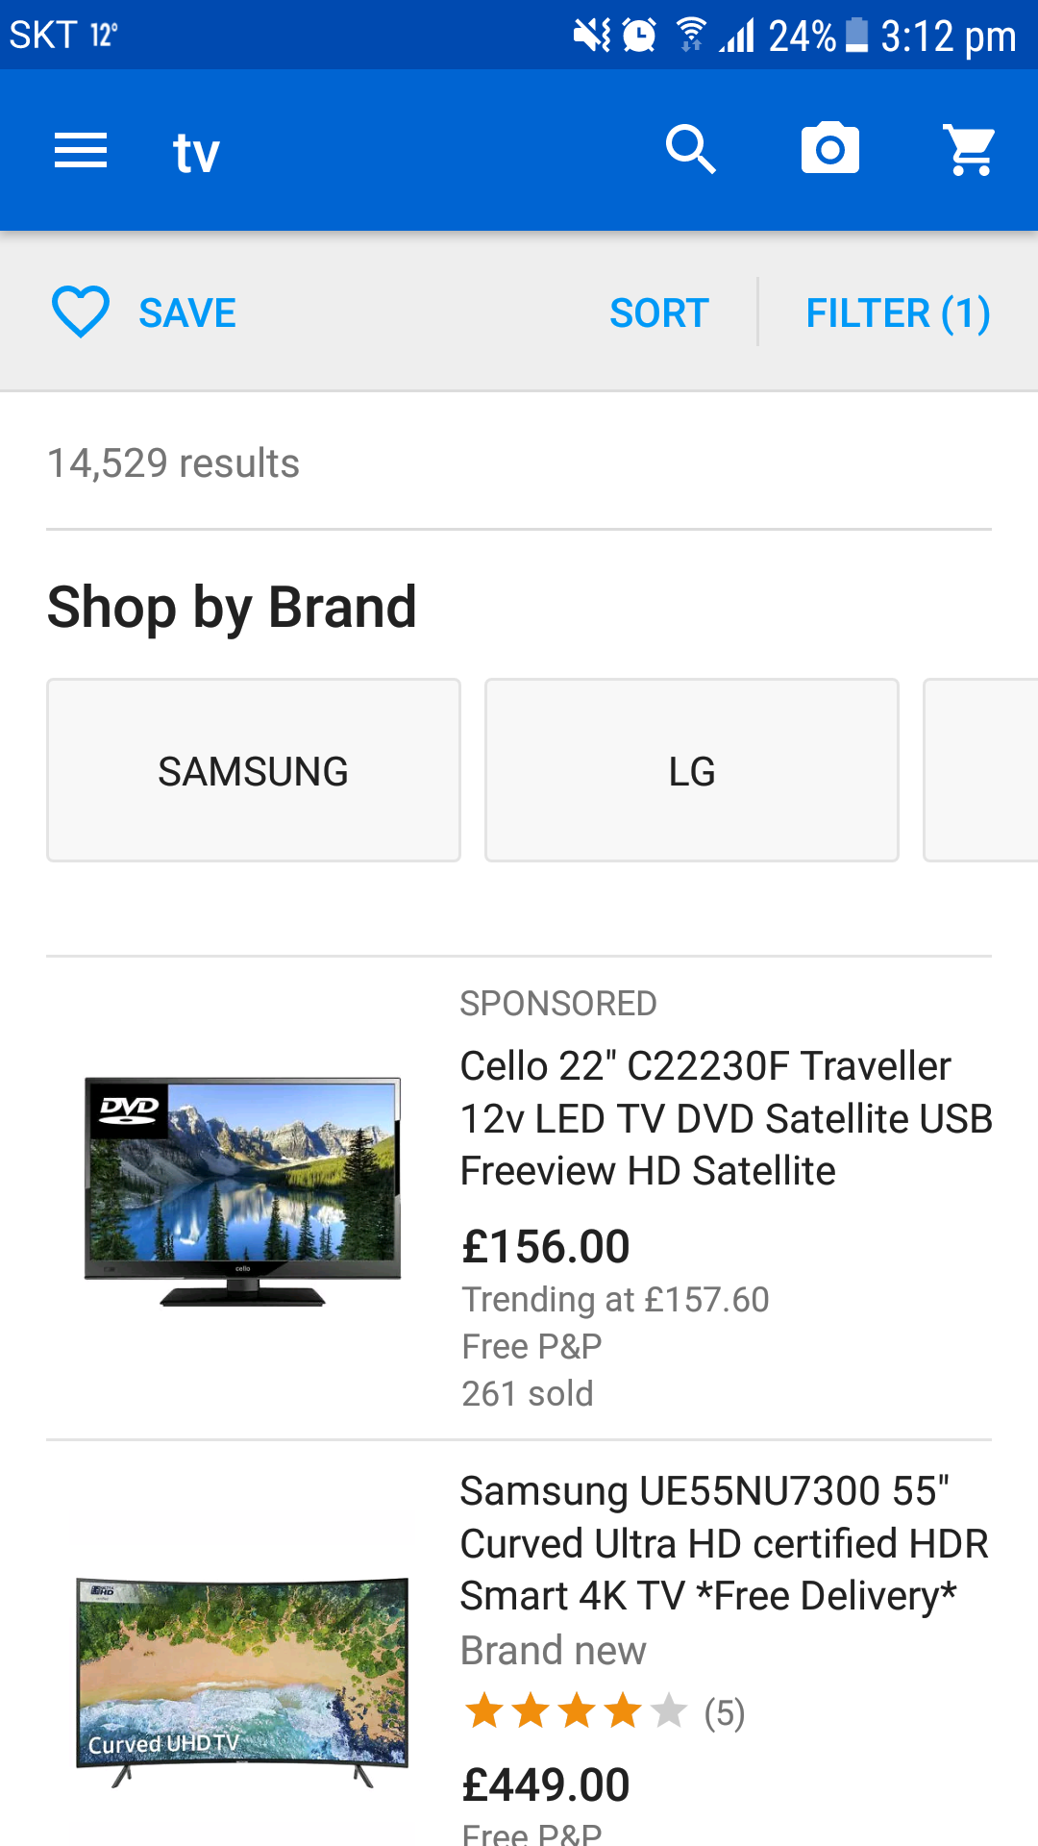
Case Studies: Ebay
Search Results
Large picture
Clear price
Think we would also need location

Slide 6
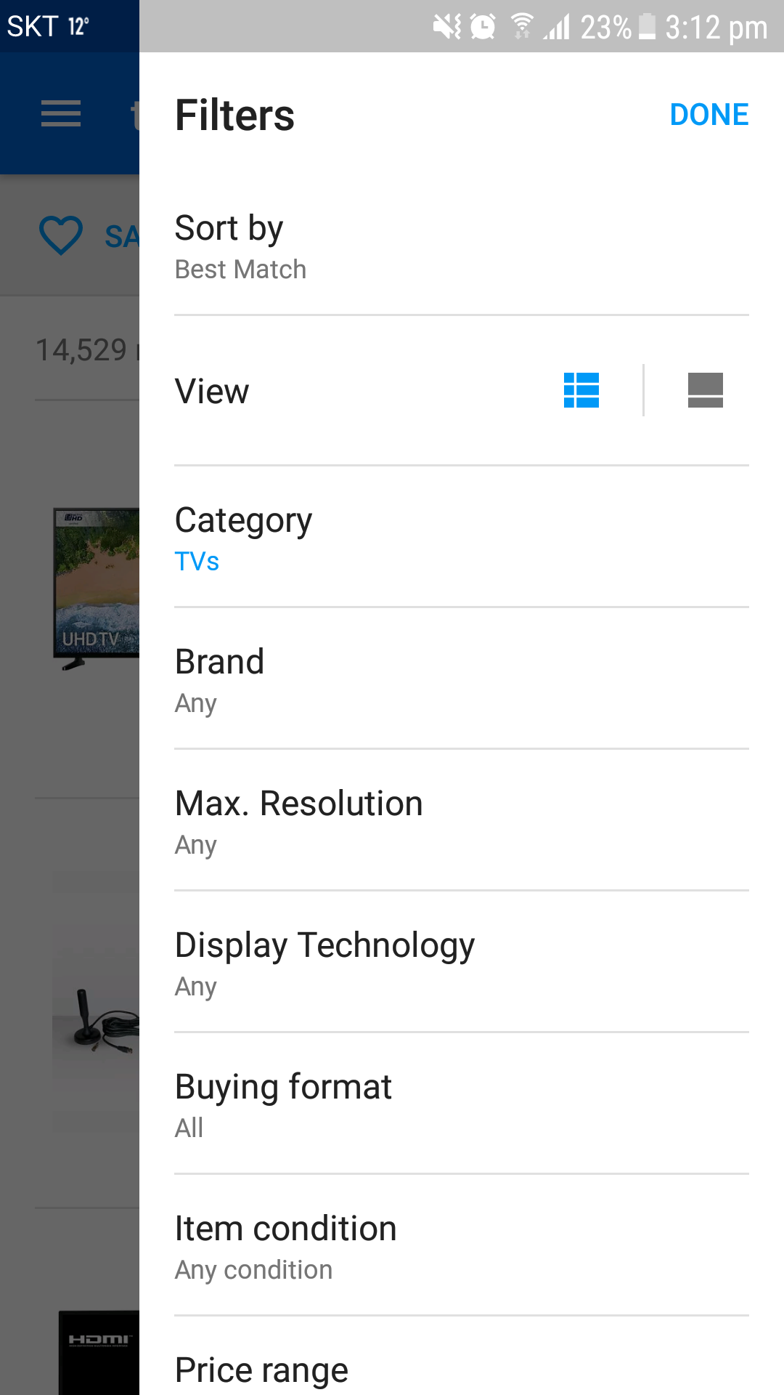
Case Studies: Ebay
Search Filters
Sort by:
'Best Match'
'Location' (distance?)
'Age: Newest'
'Age: Oldest'
'Price: Low'
'Price High'

Slide 7
Application Design
Device
Server
User Interface
RDMS
JS call
Angular
JSON
REST
Ajax Engine
(JavaScript/TS)
HTTP Request

Slide 8
Business Strategy
All listings free
Listings last 1 month(?)
Sponsored Listings
Google Ads?
After usebase established start to charge for listings

